Slide 1
Simple Statistics
Many programs deal with large collections of similar information.
Words in a document
Students in a course
Data from an experiment
Customers of a business
Graphics objects drawn on the screen
Cards in a deck

Slide 2
List

Slide 3
Examples
Apple, Banana, Berry, Mango
Football, Basketball, Throwball, Tennis, Hockey
Sunrise, Sugar, Cheese, Butter, Pickle, Soap, Washing Powder, Oil….
Agra, Delhi, Kashmir, Jaipur, Kolkata…

Slide 4
Introduction
Contains multiple values that are logically related
List is a type of mutable sequence in Python
Each element of a list is assigned a number – index / position
Can do indexing, slicing, adding, multiplying, and checking for membership
Built-in functions for finding length of a sequence and for finding its largest and smallest elements

Slide 5
What is a List?
Most versatile data type in Python
Comma-separated items can be collected in square brackets
Good thing is..
THE ITEMS IN THE LIST NEED NOT BE OF SAME TYPE

Slide 6
Creating a list
Creating an EMPTY list
listname = []
Example:
L1 = []
MyList = []
Books = []
Creating a list with items
listname = [item1, item2, ….]
Example:
Temp = [100, 99.8, 103, 102]
S = [‘15BIT0001’, ‘Achu’, 99.9]
L2 = [1, 2, 3, 4, 5, 6, 7]
Course = [‘Python’, ‘C’, ‘C++’, ‘Java’]

Slide 7
Accessing Values
Using index or indices
>>>L1 = [1, 2, 3, 4, 5, 6]
>>>print (L1[3]) #indexing
>>>4
>>>print (L1[2:5]) #slicing
>>>[3, 4, 5]

Slide 8
Updating Elements
Update an element in list using index
>>>L1 = [1, 2, 3, 4, 5, 6]
>>>L1[2] = 111
>>>L1
[1, 2, 111, 4, 5, 6]

Slide 9
Deleting Elements
Delete an element in list using index
>>>L1 = [1, 2, 3, 4, 5, 6]
>>>del L1[4]
>>>L1
[1, 2, 111, 4, 6]

Slide 10
Basic Operations in List
>>> len([1, 2, 3]) # Length
3
>>> [1, 2, 3] + [4, 5, 6] # Concatenation
[1, 2, 3, 4, 5, 6]
>>> ['Ni!'] * 4 # Repetition ['Ni!', 'Ni!', 'Ni!', 'Ni!']

Slide 11
Basic Operations in List
>>> str([1, 2]) + "34" # Same as "[1, 2]" + "34"
'[1, 2]34'
>>> [1, 2] + list("34")
# Same as [1, 2] + ["3", "4"]
[1, 2, '3', '4‘]

Slide 12
List Iteration
>>> 3 in [1, 2, 3] # Membership
True
>>> for x in [1, 2, 3]:
print(x, end=' ')

Slide 13
List Comprehensions
# List comprehension equivalent ...
>>> res = []
>>> for c in 'SPAM':
res.append(c * 4)
>>> res
['SSSS', 'PPPP', 'AAAA', 'MMMM']

Slide 14
Indexing, Slicing
>>> L = ['spam', 'Spam', 'SPAM!']
>>> L[2] # Offsets start at zero
'SPAM!'
>>> L[−2] # Negative: count from the right
'Spam'
>>> L[1:] # Slicing fetches sections
['Spam', 'SPAM!']

Slide 15
Matrixes
a basic 3 × 3 two-dimensional list-based array: >>> matrix = [[1, 2, 3], [4, 5, 6], [7, 8, 9]]
With one index, you get an entire row (really, a nested sublist), and with two, you get an item within the row:
>>> matrix[1]
[4, 5, 6]

Slide 16
Matrixes
>>> matrix[1][1]
5
>>> matrix[2][0]
7
>>> matrix = [[1, 2, 3],
[4, 5, 6],
[7, 8, 9]]
>>> matrix[1][1]
5

Slide 17
Insertion, Deletion and Replacement
>>> L = [1, 2, 3]
>>> L[1:2] = [4, 5] # Replacement/insertion
>>> L
[1, 4, 5, 3]
>>> L[1:1] = [6, 7] # Insertion (replace nothing)
>>> L
[1, 6, 7, 4, 5, 3]
>>> L[1:2] = [] # Deletion (insert nothing)
>>> L
[1, 7, 4, 5, 3]

Slide 18
Insertion, Deletion and Replacement
>>> L = [1]
>>> L[:0] = [2, 3, 4]
# Insert all at :0, an empty slice at front
>>> L
[2, 3, 4, 1]
>>> L[len(L):] = [5, 6, 7]
# Insert all at len(L):, an empty slice at end
>>> L
[2, 3, 4, 1, 5, 6, 7]

Slide 19
List method calls
>>> L = ['eat', 'more', 'SPAM!']
>>> L.append('please')
# Append method call: add item at end
>>> L
['eat', 'more', 'SPAM!', 'please']
>>> L.sort() # Sort list items ('S' < 'e')
>>> L
['SPAM!', 'eat', 'more', 'please']

Slide 20
More on Sorting Lists
>>> L = ['abc', 'ABD', 'aBe']
>>> L.sort() # Sort with mixed case
>>> L
['ABD', 'aBe', 'abc']
>>> L = ['abc', 'ABD', 'aBe']
>>> L.sort(key=str.lower) # Normalize to lowercase
>>> L
['abc', 'ABD', 'aBe']

Slide 21
More on Sorting Lists
>>> L.sort(key=str.lower, reverse=True)
# Change sort order
>>> L ['aBe', 'ABD', 'abc']

Slide 22
Other common list methods
>>> L = [1, 2]
>>> L.extend([3, 4, 5])
# Add many items at end (like in-place +)

Slide 23
Other common list methods
>>> L [1, 2, 3, 4]
>>> L.reverse() # In-place reversal method
>>> L [4, 3, 2, 1]

Slide 24
Other common list methods
>>> L = ['spam', 'eggs', 'ham']
>>> L.index('eggs') # Index of an object (search/find)
1
>>> L.insert(1, 'toast') # Insert at position
>>> L
['spam', 'toast', 'eggs', 'ham']
>>> L.remove('eggs') # Delete by value
>>> L
['spam', 'toast', 'ham']

Slide 25
Other common list methods
>>> L.pop(1) # Delete by position 'toast'
>>> L
['spam', 'ham']
>>> L.count('spam') # Number of occurrences 1
1

Slide 26
Other common list methods
>>> L = ['spam', 'eggs', 'ham', 'toast']
>>> del L[0] # Delete one item
>>> L ['eggs', 'ham', 'toast']
>>> del L[1:] # Delete an entire section
>>> L # Same as L[1:] = []
['eggs‘]

Slide 27
Other common list methods
>>> L = ['Already', 'got', 'one']
>>> L[1:] = []
>>> L
['Already']
>>> L[0] = []
>>> L
[[]]

Slide 28
Map
map built-in function applies a function to items in a sequence and collects all the results in a new list
>>> list(map(abs, [−1, −2, 0, 1, 2]))
# Map a function across a sequence
[1, 2, 0, 1, 2]

Slide 29
Hence…
A list is a sequence of items stored as a single object.
Items in a list can be accessed by indexing, and sub lists can be accessed by slicing.
Lists are mutable; individual items or entire slices can be replaced through assignment statements.
Lists support a number of convenient and frequently used methods.
Lists will grow and shrink as needed.

Slide 30
Strings and Lists
>>> S = 'spammy'
>>> L = list(S)
>>> L
['s', 'p', 'a', 'm', 'm', 'y']
>>> L[3] = 'x' # Works for lists, not strings
>>> L[4] = 'x‘
>>> L
['s', 'p', 'a', 'x', 'x', 'y']
>>> S = ''.join(L) #uses ‘’ for joining elements of list
>>> S
'spaxxy‘

Slide 31
Strings and Lists
>>> 'SPAM'.join(['eggs', 'sausage', 'ham', 'toast']) 'eggsSPAMsausageSPAMhamSPAMtoast‘
# uses ‘SPAM’ for joining elements of list
>>> line = 'aaa bbb ccc'
>>> cols = line.split( )
>>> cols
['aaa', 'bbb', 'ccc']

Slide 32
Statistics using List
Find the mean, standard deviation and median of a set of numbers

Slide 33
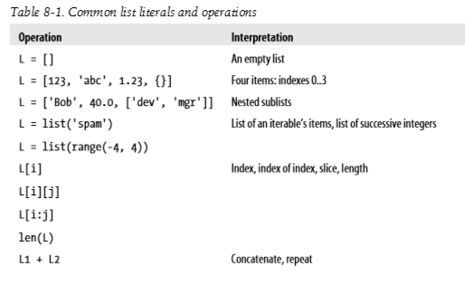

Slide 34
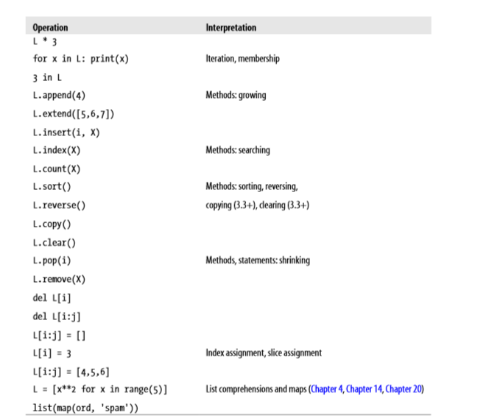

Slide 35
Exercise 1
Given a positions of coins of player1 and player2 in a 3X3 Tic Tac Toc board, write a program to determine if the board position is a solution and if so identify the winner of the game. In a Tic Tac Toc problem, if the coins in a row or column or along a diagonal is of the same player then he has won the game. Assume that player1 uses ‘1’ as his coin and player2 uses '2' as his coin. '0' in the board represent empty cell.

Slide 36
Exercise 2
In a supermarket there are two sections S1 and S2. The sales details of item₁ to item_{n} of section1 and item₁ to item_{p} of section2 are maintained in a sorted order. Write a program to merge the elements of the two sorted lists to form the consolidated list.

Slide 37
Exercise 3
Watson gives Sherlock an list of N numbers. Then he asks him to determine if there exists an element in the list such that the sum of the elements on its left is equal to the sum of the elements on its right. If there are no elements to the left/right, then the sum is considered to be zero.

Slide 38
Exercise 5
Given a list of integer values, find the fraction of count of positive numbers, negative numbers and zeroes to the total numbers. Print the value of the fractions correct to 3 decimal places.

Slide 39
Exercise 6
Given N integers, count the number of pairs of integers whose difference is K.

